Slide 1
CATIA V5 Surface Design Sample Exam
22nd June 2014

Slide 2
CATIA V5 Surface Design – Sample Exam
DISCLAIMER:
The purpose of this sample exam is to show you the format and approximate difficulty level of the real exam. It is not meant to give away the whole exam
The questions are an example of what to expect in the real exam.
How to take this sample exam:
To best simulate the conditions of the real exam, it is best NOT to print this exam. Since the tester software window runs concurrently with CATIA, you must switch back and forth between the two applications. Keeping this document open and consulting it on your computer while running CATIA is the best method to simulate the real exam conditions.
The multiple choice answers should serve as a check for you to ensure that your model is on the right track while completing this exam. If you do not find your answer in the selections offered then, most likely, there is something wrong with your model at that point.
Answers to the questions are on the last pages of this sample exam document. There are also hints that can help you save time during the exam.
If you can complete this exam and get at least 4 correct answers out of the 5 questions in 30 minutes or less, then you should be ready to take the real certification exam.
Do not forget to save your work after each question in a different file in case it must be reviewed

Slide 3
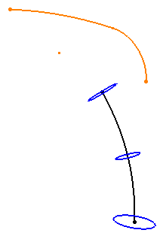
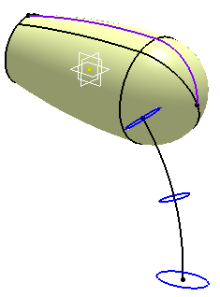
CATIA V5 Surface Design – Sample Exam
Question 1
A
B
Open Surface.CATPart.
As shown in illustration A, create a Revolute surface using Sketch.1. Resulting surface is shown in illustration B
Question 1: What is the surface area of resulting surface?
a) 856.5 sq-mm b) 955.7.0 sq-mm
c) 1090.8 sq-mm d) 1123.5 sq-mm
Hint: To measure the area, click the Measure item tool and then select the surface in the tree or graphics area.

Slide 4
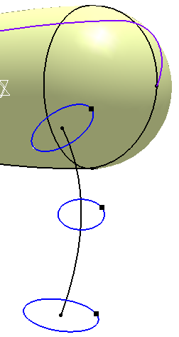
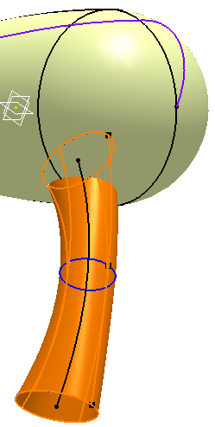


CATIA V5 Surface Design – Sample Exam
Question 2
A
B
Refer to illustration A. Create a Multi-sections surface using Sketch.3, Sketch.4 and Sketch.5. Use Point.3, Point.4 and Point.5 respectively as the closing points. Use Sketch.2 as the Spline. Resulting surface is shown in illustration B.
Further instructions related to Question 2 are given in the next screen.

Slide 5
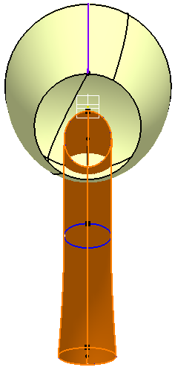
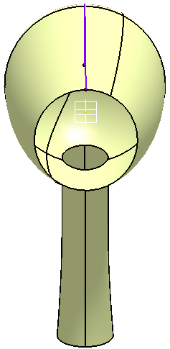
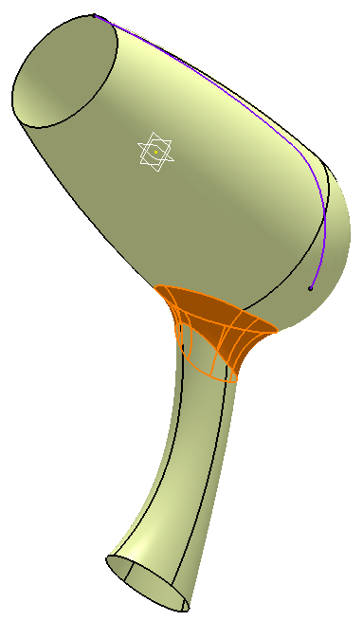
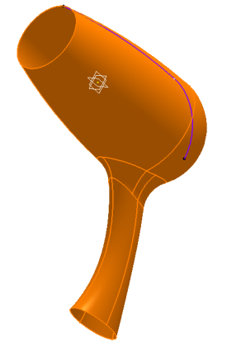
CATIA V5 Surface Design – Sample Exam
Question 2 (continued…)
C
D
E
Refer to illustration C. Cut the intersecting portions of the two surfaces. Resulting surface is shown in illustration D.
Refer to illustration E. Apply a fillet of 2mm radius on the intersecting edge.
Question 2: What is the surface area of the entire surface?
sq-mm

Slide 6
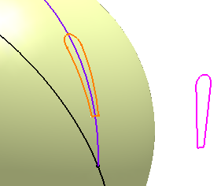
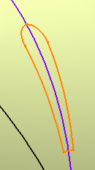
CATIA V5 Surface Design – Sample Exam
Question 3
A
B
From the INPUT geometrical set, unhide Sketch.6 and Line.1
Refer to illustration A. Project Sketch.6 on the surface. Use Line.1 as the direction of projection.
Question 3: Refer to illustration B. What is the length of the projected curve
L = ?
mm

Slide 7
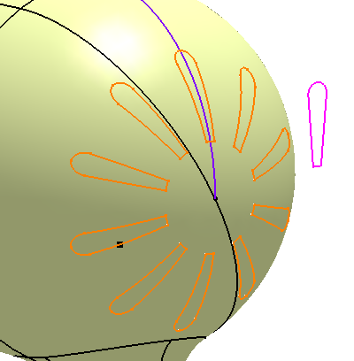
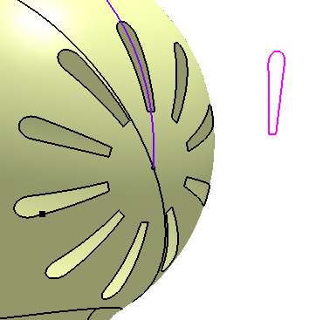
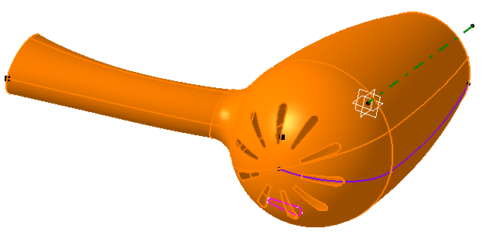
CATIA V5 Surface Design – Sample Exam
Question 4
A
B
Refer to illustration A. Pattern the projected curve and create 10 equally spaced instances. Use Line.1 as the reference axis.
Refer to illustration B. Cut the surface using curves created in the previous step.
Question 4: Refer to illustration C. What is the surface area of the entire surface.
a) 1314.5 sq-mm b) 1308.7.0 sq-mm
c) 1290.8 sq-mm d) 1327.5 sq-mm
C

Slide 8
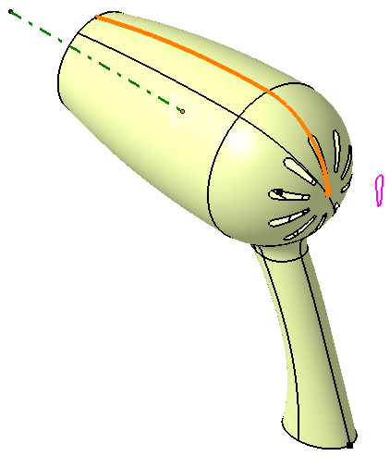
CATIA V5 Surface Design – Sample Exam
Question 5
A
Question 5: Refer to illustration A. What is the maximum radius of curvature for Sketch.1?
mm

Slide 9
CATIA V5 Surface Design – Sample Exam
Answers
c) 1090.8 sq-mm
1329.0 sq-mm
7.84 mm
b) 1308.7.0 sq-mm
82.68 mm

